Slide 1



GHOST IMAGING
SPOOKY IMAGING USING ARTIFICIAL INTELLIGENCE !

Slide 2

WAIT…..DOES THAT MEAN AI HELPS US SEE GHOSTS???

Slide 3


Slide 4

A BIT DISHEARTENED TO HEAR THAT?
What if I say u that it will help you see things not visible with human vision?
INTERESTING RIGHT?

Slide 5

WHAT IS GHOST IMAGING?

Slide 6

WHAT IS GHOST IMAGING?
TO UNDERSTAND THAT LETS UNDERSTAND THE DIFFERENCE BETWEEN NORMAL CONVENTIONAL IMAGING AND GHOST IMAGING AND WHAT MAKES THIS SO DIFFERENT.
READY FOR SPOOKY IMAGING? LESS GOOOOO…

Slide 7

CONVENTIONAL IMAGING…
THE BASIC PRINCIPLE FOLLOWED THERE IS THAT WE POINT DETECTER AT SOME OBJECT WHICH EITHER EMITS LIGHT OR WE ILLUMILINATE THE OBJECT WITH SOME FLASH LIGHT.
Light comes towards the detector…..
Two dimensional detector is used to see the image resolution.
QUITE SIMPLE IS’NT IT?

Slide 8
ASSUMPTIONS IN CONVENTIONAL IMAGING
Light travels from object to detector
The dimensions of detector should match that of the screen on which image is projected.

Slide 9
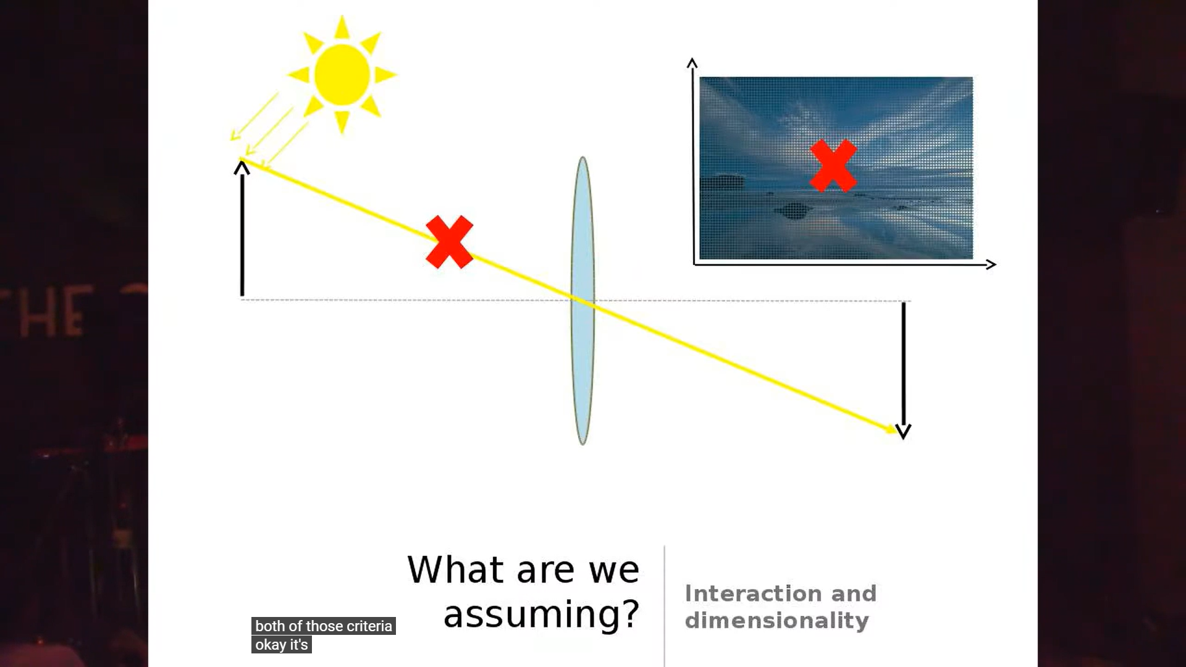
But what if we remove both the assumptions??
THAT’S WHAT WE DO IN GHOST IMAGING……NO ASSUMPTIONS….INTERESTING RIGHT?

Slide 10

SO HOW DOES GHOST IMAGING WORK?
It is technique that produces an image of an object by combining information from two light detectors: a conventional, multi-pixel detector that doesn't view the object, and a single-pixel (bucket) detector that does view the object.

Slide 11

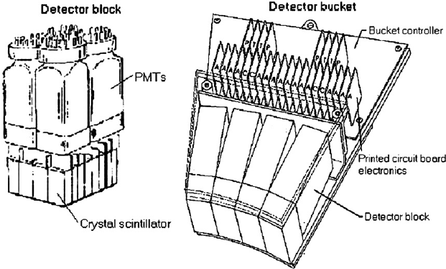
Mechanism
Imagine two transparent boxes: one that is empty and one that has an object within it. The back wall of the empty box contains a grid of many pixels (i.e. a camera), while the back wall of the box with the object is a large single-pixel (a bucket detector.)
Fig: showing a bucket detector

Slide 12
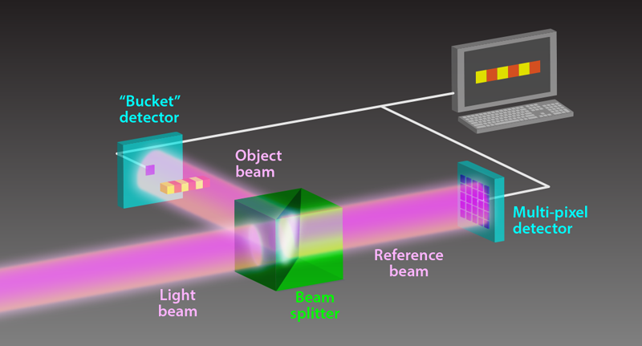
FIG: SHOWING HOW LIGHT BEAM SPLITS AND PHOTONS MOVE.

Slide 13
AND THE LAST STEP…
A processor receiving a signal from both light detectors only records a pixel of an image when light hits both detectors at the same time. In this way, a silhouette image can be constructed, even though the light going towards the multi-pixel camera did not touch the object.

Slide 14
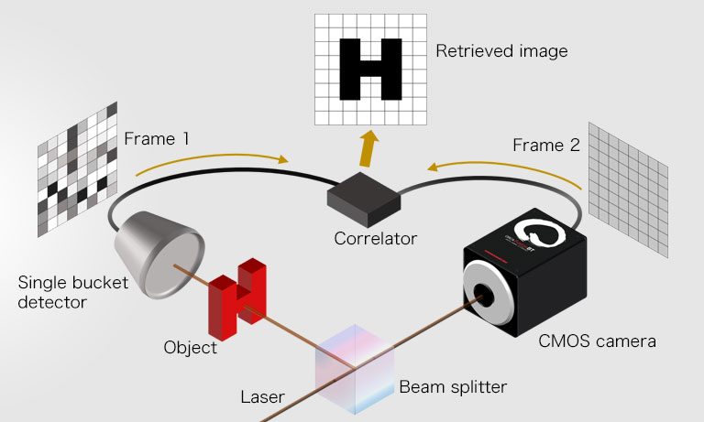
FIG: SHOWING THE COMPLETE GHOST IMAGING PROCEDURE…..

Slide 15


BUT, LETS MAKE A SMALL CHANGE…
WHAT IF WE REPLACE THE CAMERA LENS WITH
OUR OWN EYES????
WILL WE NEED A CORRELATOR IN THAT CASE?
WILL OUR EYES BE ABLE TO FIGURE OUT THE IMAGE FROM SCATTERED PHOTONS?

Slide 16
WELL, THAT’S WHERE AI COMES INTO PLAY… The human subjects wear an EEG helmet, which is able to read signals in their visual cortex.

Slide 17
WELL, THAT’S WHERE AI COMES INTO PLAY… The human subjects wear an EEG helmet, which is able to read signals in their visual cortex.
BUT, WHAT ON EARTH IS AN EEG HELMET???

Slide 18
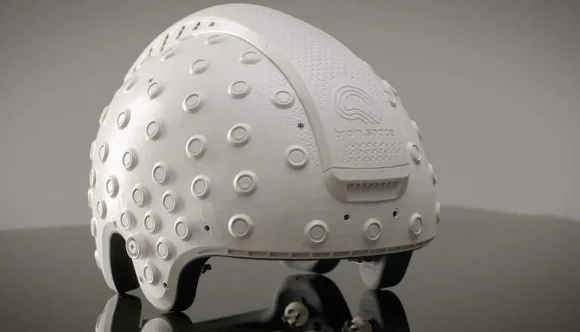
BASICALLY, Electroencephalography (EEG) is a monitoring method to record the electrical activity of the brain. Wearable EEG headsets position noninvasive electrodes along the scalp. The clinical definition of EEG is the recording of brain activity over a period of time. EEG electrodes pick up on and record the electrical activity in your brain. The collected signals are amplified and digitized, and then sent to a computer or mobile device for storage and data processing.
EEG HELMET
SEEMS COOL RIGHT???

Slide 19
NOW, COMING BACK TO OUR DISCUSSION,
These signals received are fed into a laptop running AI algorithms which can then decode the scattered light and identify the object. The strength of the EEG signal roughly correlates with the intensity of light on different areas of the wall, so the algorithm is able to use this to “carve” the correct image out of the diffused light.
WANNA SEE HOW THE SETUP LOOKS? LETSSS SEEEEE…….

Slide 20
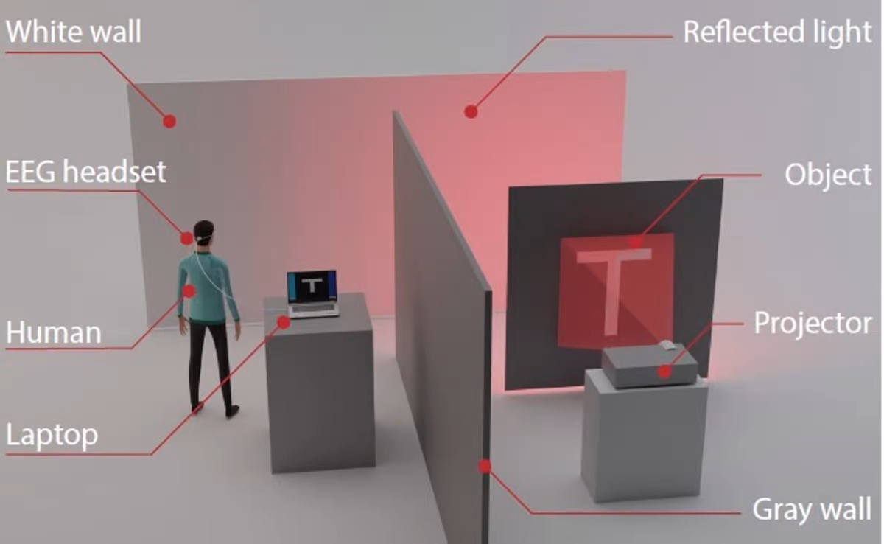
THE GHOST-IMAGING SETUP

Slide 21
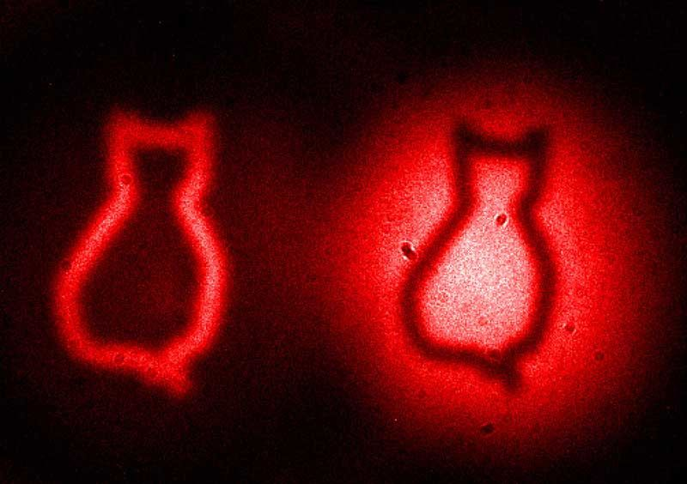
REAL IMAGES OF GHOST IMAGING AS PERCIEVED …… INTERESTING, ISN’T IT?
In this test, the“object” was a 16 x 16-pixel image, with the light patterns which flickered at a frequency of 6 Hz for two seconds. And sure enough, after about a minute of observation of the light, the system was able to accurately reconstruct each part of the object..

Slide 22

WHAT makes Ghost Imaging so special??
This is one of the first times that computational imaging has been performed by using the human visual system in a neurofeedback loop that adjusts the imaging process in real time.

Slide 23
FUTURE ADVANCEMENTS WHICH CAN BE THOUGHT OF……
3D imaging
Multiple viewers
investigate imaging objects in three dimensions
combining data from multiple viewers at the same time
AND MANY MORE …….WHAT DO YOU THINK?

Slide 24

AND LASTLY BUT NOT THE LEAST………
MAYBE, SOMEDAY, WE MAY BE ABLE TO IMAGE ACTUAL GHOSTS TOO….MAYBE EVEN THE ONE STANDING BEHIND YOU???
AND MAYBE IT WOULD LOOK LIKE THIS??

Slide 25
AND LETS CONCLUDE……
FIRSTLY…..THANKS….
THIS WAS A TOPIC I WANTED TO SURF ABOUT…SINCE LONG….BUT OFCOURSE…KEPT ON DELAYING…..BUT FINALLY..WAS ABLE TO LEARN A BIT ABOUT IT AND PRESENT TO YOU GUYS WHATEVER I LEARNT………
THANKS AGAIN FOR LISTENING ……

Slide 26
RESOURCES USED….
https://newatlas.com/technology/ghost-imaging-non-line-of-sight-see-around-corners/
https://en.wikipedia.org/wiki/Ghost_imaging
https://physics.aps.org/articles/v9/103
https://royalsocietypublishing.org/doi/10.1098/rsta.2016.0233

Slide 27
THE END
A PRESENTATION BY SOUMILI MUKHERJEE

